Slide 1
COLLEGE ATTENDANCE

Slide 2
INTRODUCTION:
College attendance refers to the practice of students being present in their classes, lectures, or laboratory sessions as scheduled by their institution. It is a crucial aspect of academic life that reflects student discipline, responsibility, and commitment to learning. Monitoring attendance helps both students and faculty track participation and ensures the effectiveness of the teaching-learning process.
Frontend:
HTML – Structure of web pages
CSS – Styling pages (colors, layout, fonts)
JavaScript – Dynamic behavior
Backend:
PHP – Popular for web-based attendance systems; connects easily to MySQL
Python (Flask/Django) – Alternative backend language with strong frameworks

Slide 3
STRUCTURE:
project/
│ index.php
│ register.php
page
│ dashboard.php
│ add_student.php
│ mark_attendance.php
for students
│ view_attendance.php
attendance records
│ logout.php
│ db.php
default teacher
│ style.css
bg.jpg
└─ images/
└─ bg.jpg
| ---- README.md

Slide 4
Step-by-Step Process:
First we can see the Register Teacher Account
Enter the Username and Password
Click Register option
Then go to Teacher Login Page
enter the name and password
click the Login button
After open the Dashboard. In that we can see more options .we can select
what u want.
Add Student: we can add the Details of students with name, email and
password.
Mark Attendance: mark the attendance of the students. In the Status
column
we can choose that particular student is Present or Absent .
After we can click Submit Attendance.
Then go to View Attendance page. In that we can see student data stored
with date and status of the student.
Back to Dashboard: back to dashboard.
Then choose Logout option we can log out then go to displays the again
Teacher Login page.

Slide 5
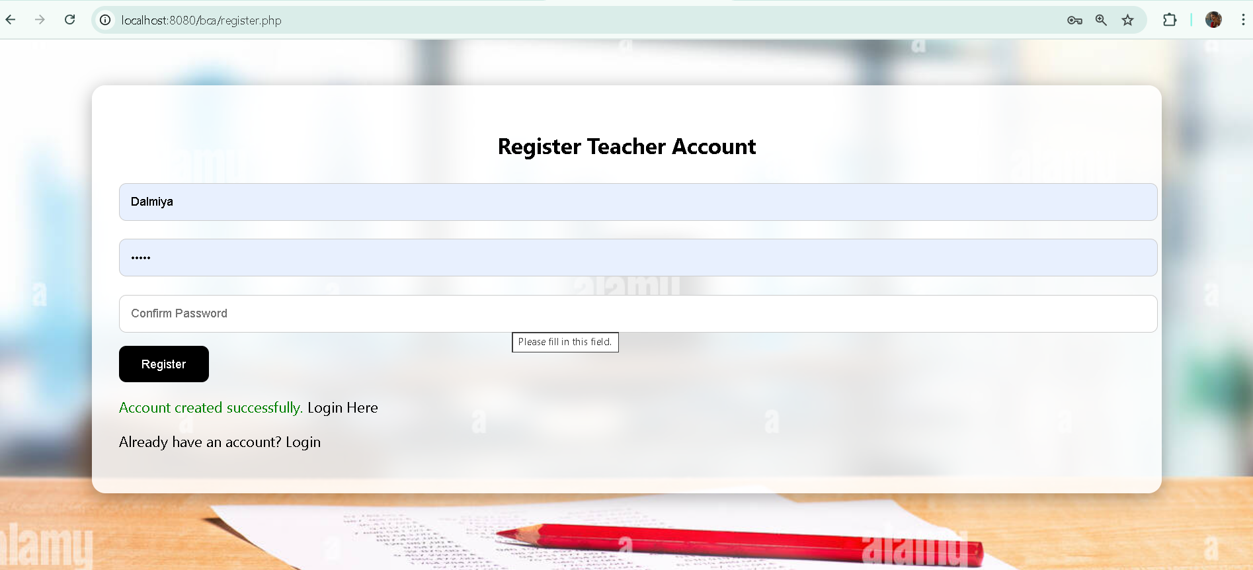
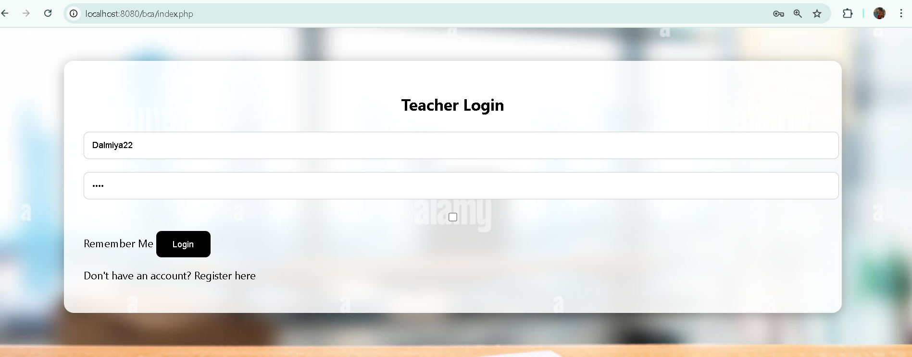
Outputs:

Slide 6
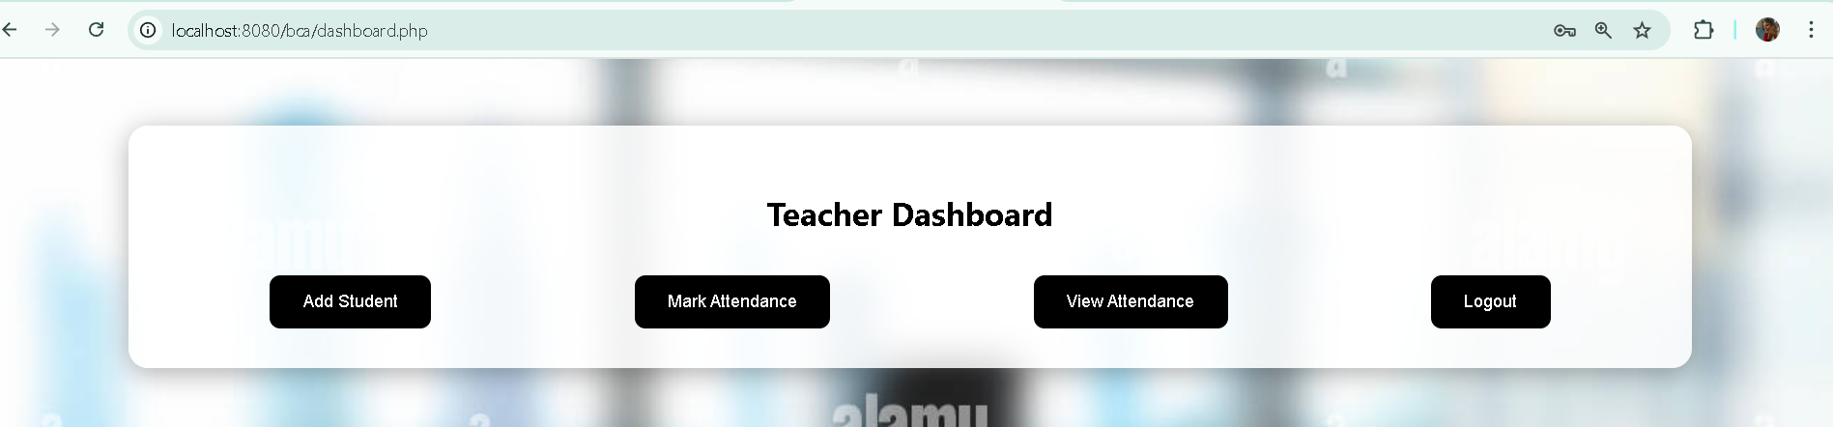
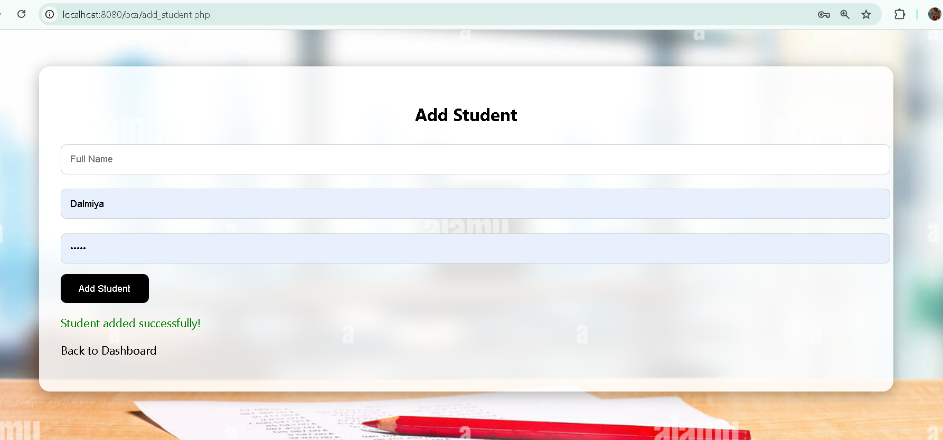

Slide 7
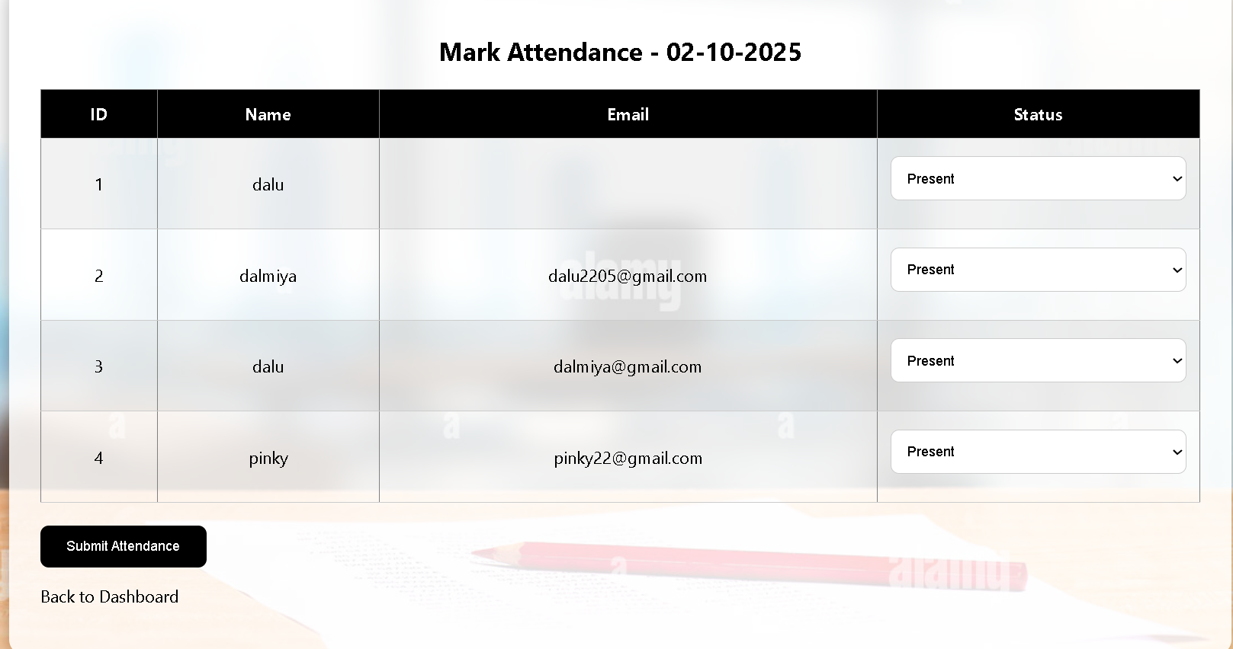
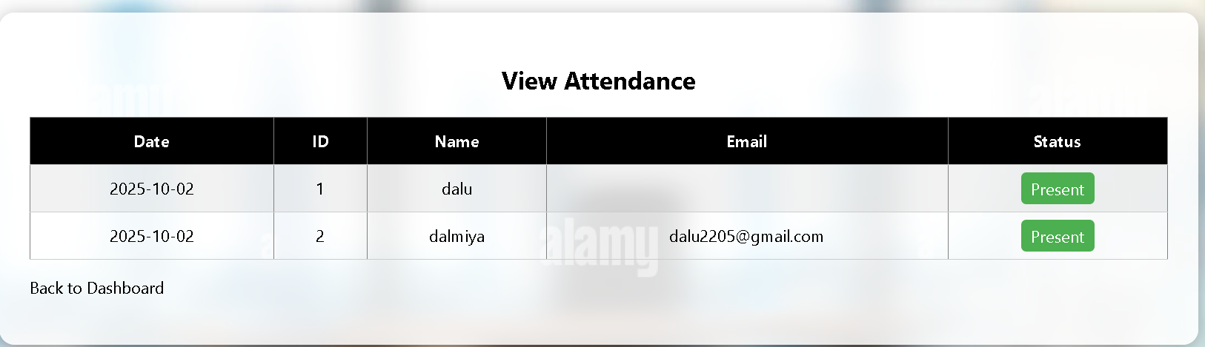

Slide 8
THANK YOU

